Slide 1
Banking Management System
Group Members:
Muhammad Umer (20K-0225)
Anas Akhtar (20K-0422)
Hassan Malik (20K-0380)-Group Leader

Slide 2
Why we chose Banking Management System
In today’s world, where technology is ruling, every single person wishes to use it, and take benefits from it. But with the introduction of new technologies, it is very difficult for people to understand them and use them, because of their complexity.
It is very difficult to bring out something new with simplicity, and it is an alarming issue in this developing world. Most people do not use e-banking for this purpose.
Keeping all this in mind, we have brought a banking management system for this world to enjoy the technology.

Slide 3
Advantages
Our banking management system is specially made to promote simplicity.
You can find all the important features of banking and atm at one place.
Use of very easy language and options.
E-banking
Security Guaranteed

Slide 4
Features
Creating Account for a new user
cash deposit,
cash withdraw (using the atm),
transfer of funds
information of the account
Receipt of any transaction
Alarm Sound if wrong data input
Changing of PIN code
And many other exciting features

Slide 5
Input
We solely used C language to develop this project.
Use of loops
Pointers
Arrays
Arrays of strings
Functions for each feature
Structures (Nested, Array of structures)
File pointer
All filing options
A text file to store account details
PlaySound file of wav type to alarm the customer on wrong inputs

Slide 6
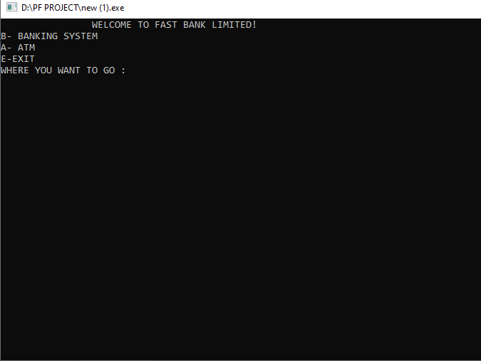
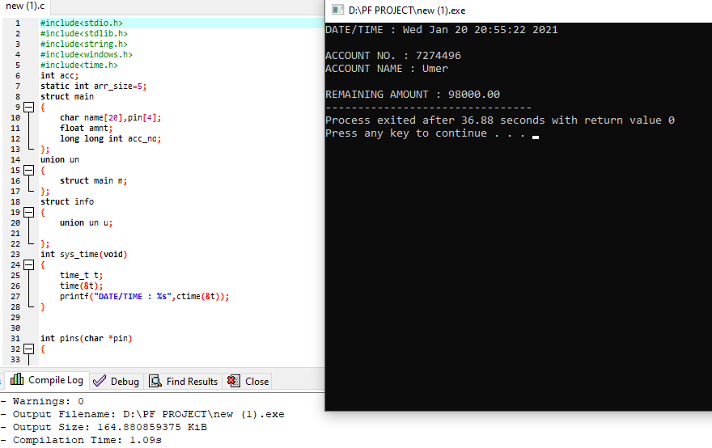
Output
Using the code, you will have an easy management system with a simpler interface

Slide 7
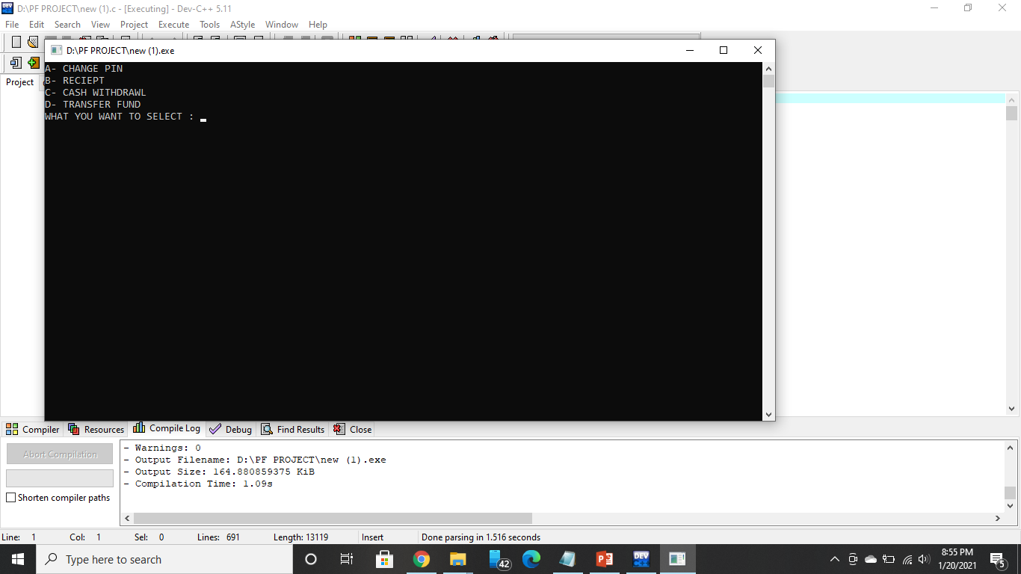
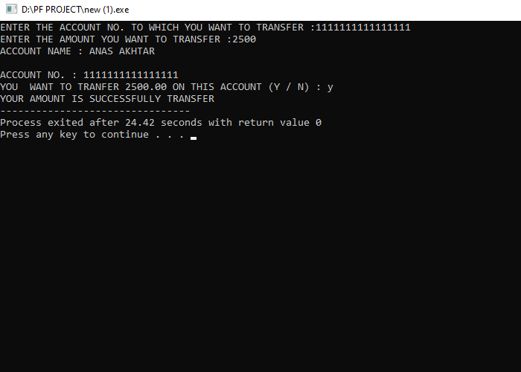
In market, you will find numerous programs for banking management system, but none of them will be as simpler, efficient and secure as the one we are providing, and because of these features market has a rising demand for these programs.

